Slide 1
Unit overview
L1: mutation, drift, Wright-Fisher
Today: natural selection I
L3: population structure and demography
L4: linkage and recombination
L5: natural selection II
L6: topic

Slide 2
Today’s agenda
Answers to in-class problem set from last time
Lecture
In-class problem set

Slide 3
Wright-Fisher model with selection
Mutation
Selection
Drift
Recombination
Migration
Allele frequencies

Slide 4

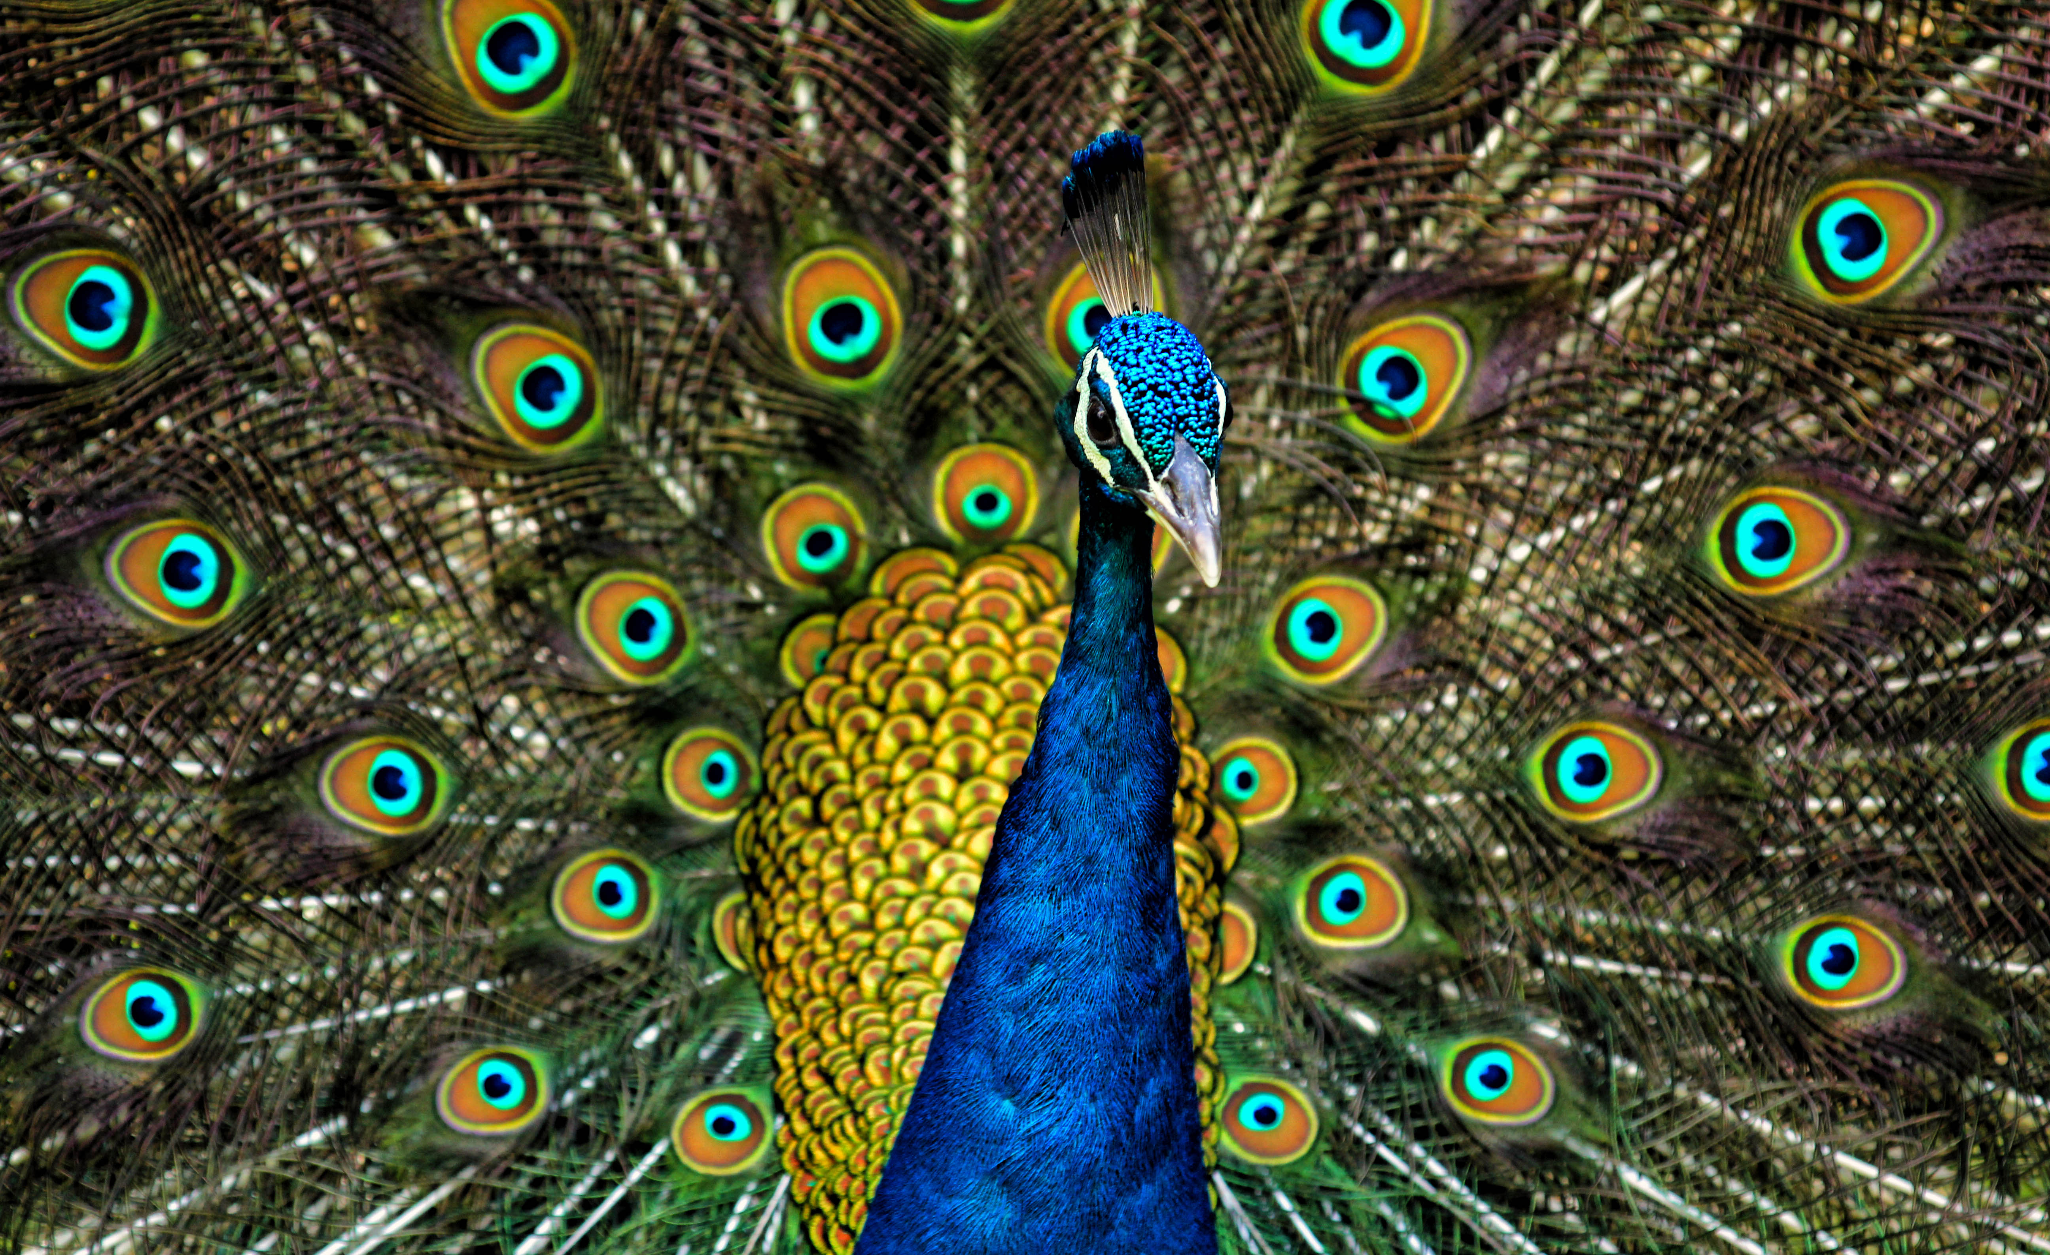
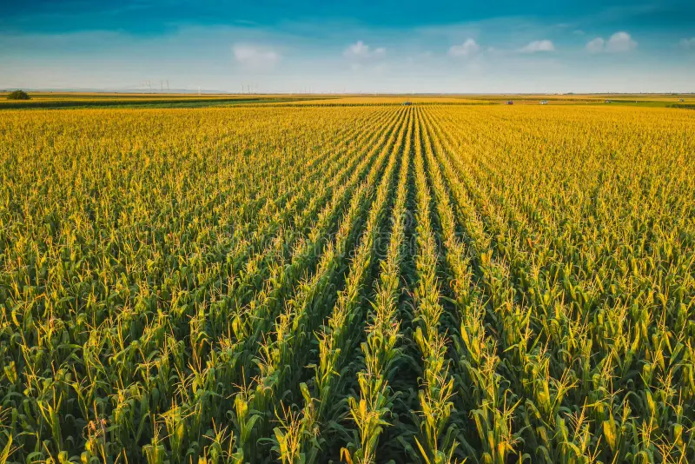
Mechanisms of selection
Natural selection (death or infertility)
Sexual selection (mate choice)
Artificial selection (breeding)

Slide 5
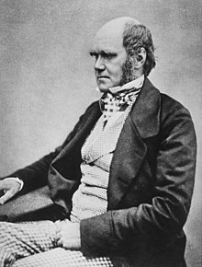
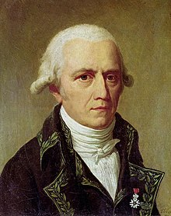
Relationship between selection and mutation
Darwinian model: selection acts on standing variation
Lamarckian model: selection induces adaptive mutations
Charles Darwin, 1809-1882
Jean-Baptiste Lamarck, 1744-1829

Slide 6
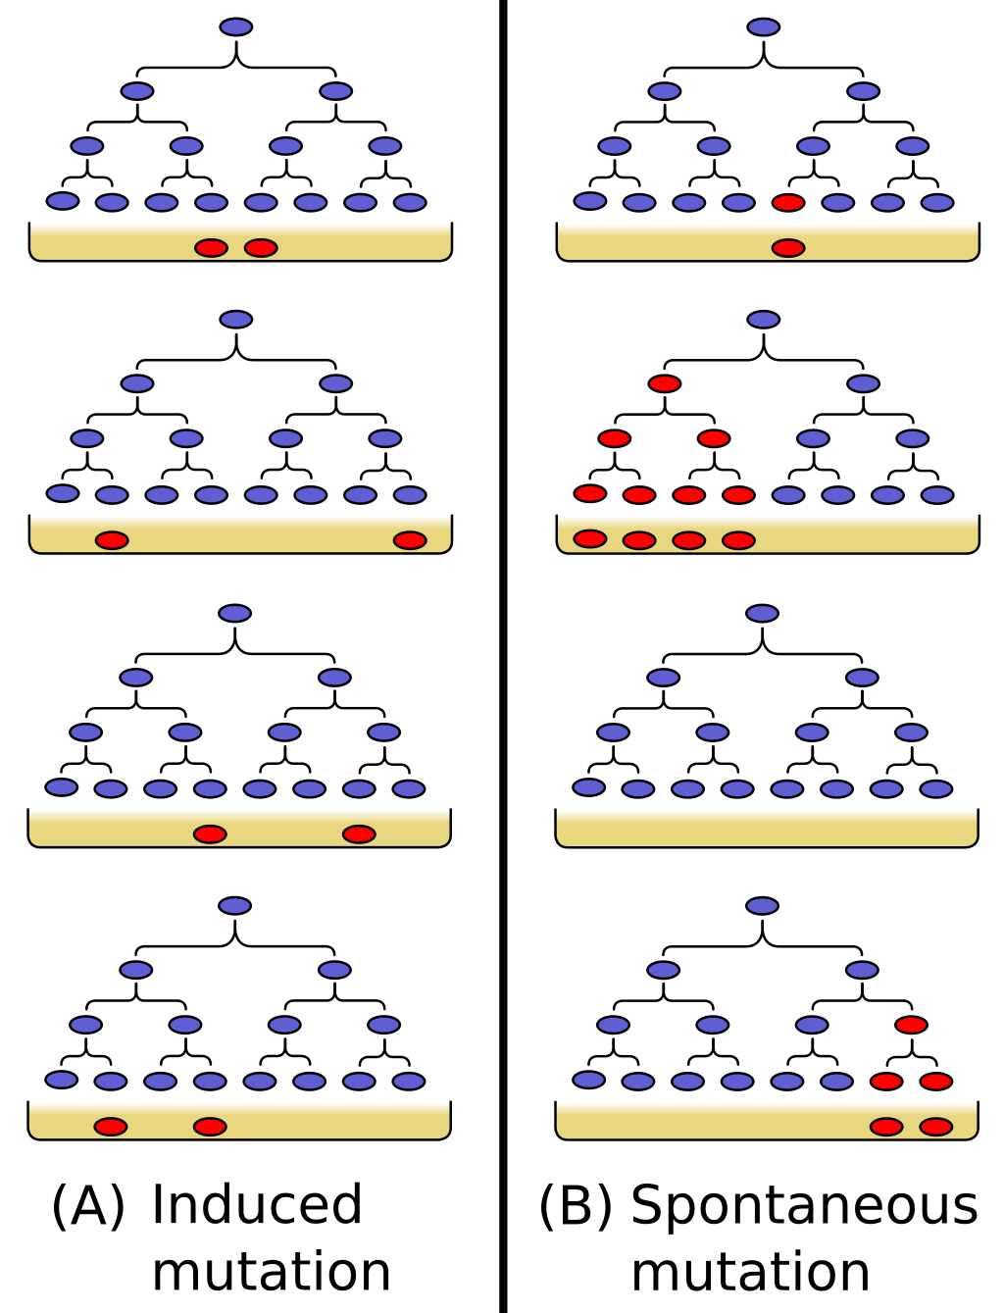
Luria-Delbruck experiment (1943)
Poisson distributed number of survivors
Overdispersion: Greater than Poisson variance in outcomes

Slide 7
Selection acts on standing variation; mutation does not respond to selection

Slide 8
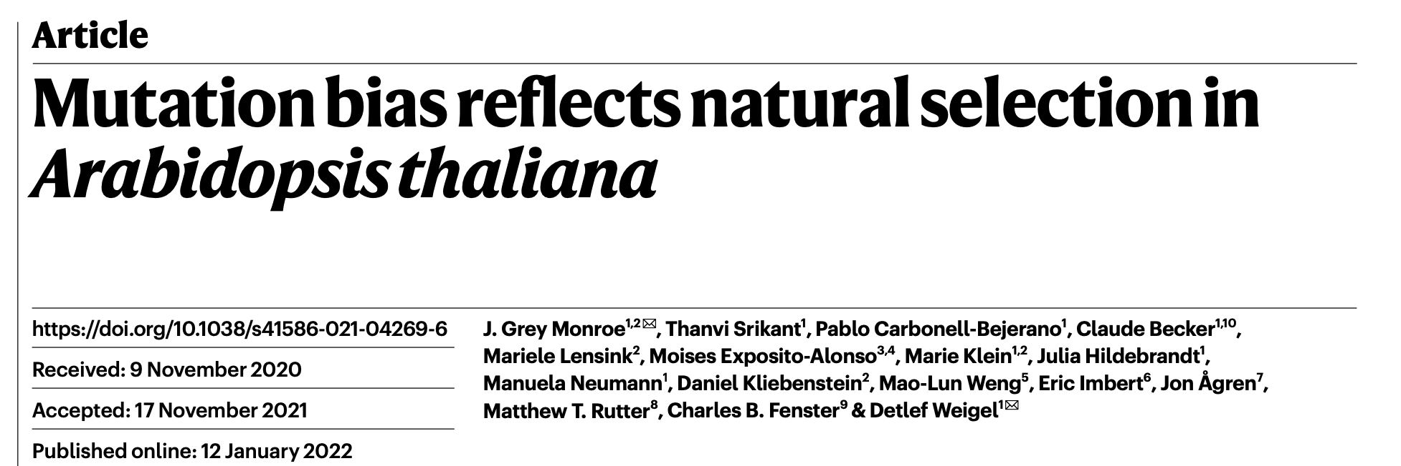
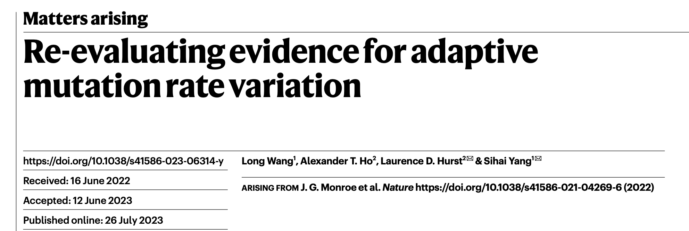
“Since the first half of the twentieth century, evolutionary theory has been dominated by the idea that mutations occur randomly with respect to their consequences.”
“However, their mutation calling has abundant sequencing and analysis artefacts.”

Slide 9
Mutations and fitness
Selective effect of mutation
Deleterious
Neutral
Advantageous
Functional
New mutation
Nonfunctional

Slide 10
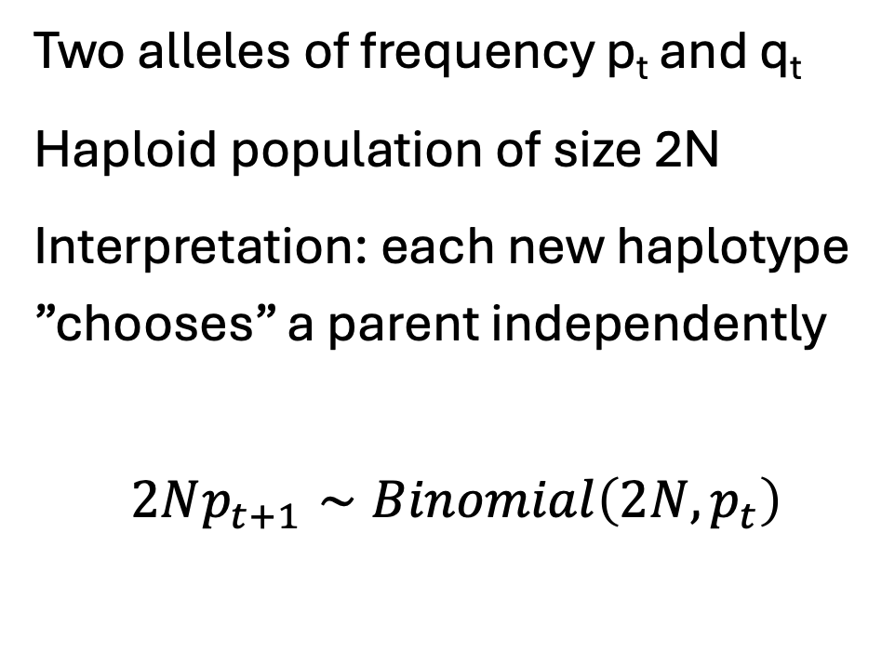
Recall: Wright-Fisher model of genetic drift
Two alleles of frequency p_{t} and q_{t}
Haploid population of size 2N
Interpretation: each new haplotype ”chooses” a parent independently
$$2Np_{t+1}∼Binomial\left(2N,p_{t}\right)$$
One generation
t
t+1

Slide 11
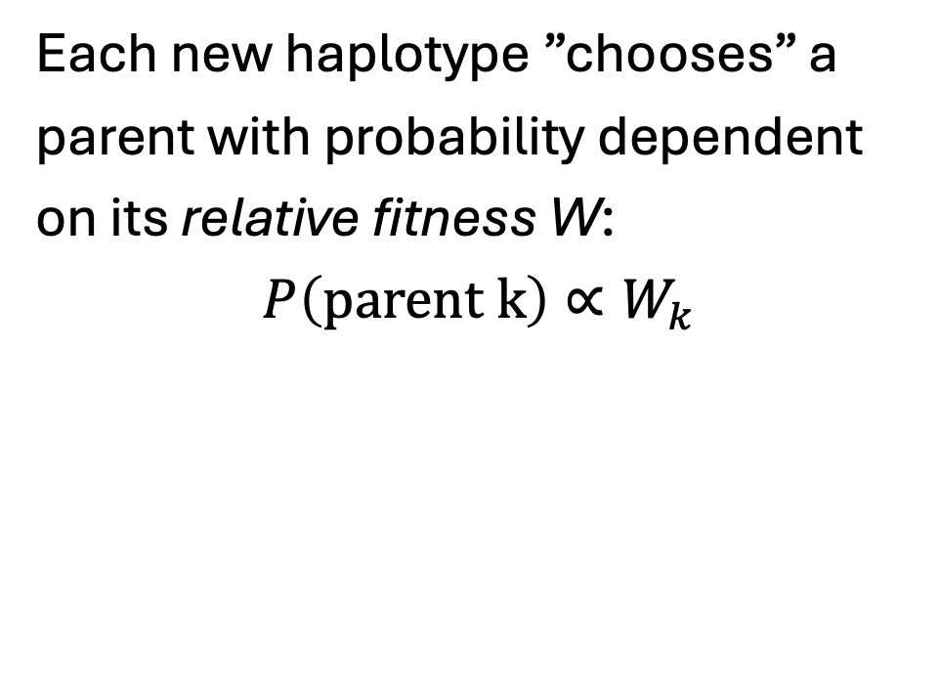
Biased Wright-Fisher sampling
Each new haplotype ”chooses” a parent with probability dependent on its relative fitness W:
$$P\left(parent k\right)∝W_{k}$$
One generation
t
t+1

Slide 12
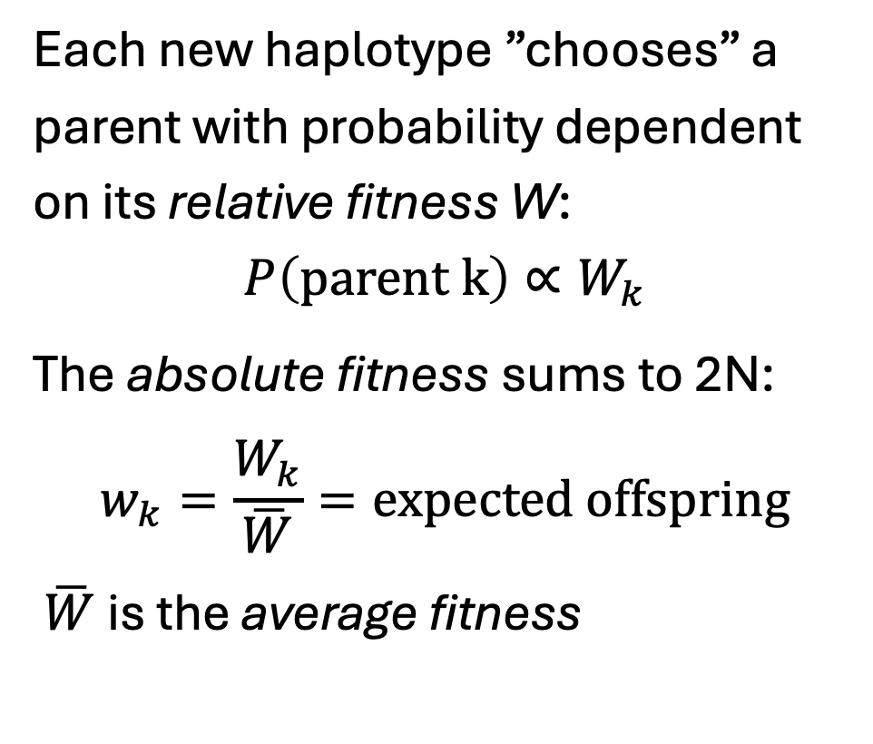
Biased Wright-Fisher sampling
Each new haplotype ”chooses” a parent with probability dependent on its relative fitness W:
$$P\left(parent k\right)∝W_{k}$$
The absolute fitness sums to 2N:
$$w_{k}=\frac{W_{k}}{\overline{W}}=expected offspring$$
$\overline{W}$ is the average fitness
One generation
t
t+1

Slide 13
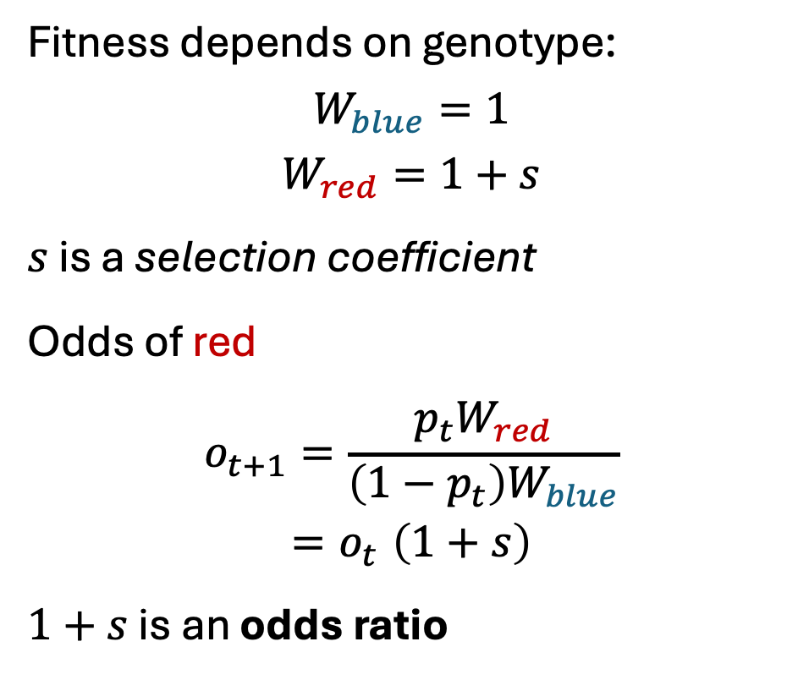
Biased Wright-Fisher sampling
Fitness depends on genotype:
$$W_{blue}=1$$
$$W_{red}=1+s$$
$s$ is a selection coefficient
Odds of red
$$o_{t+1}=\frac{p_{t}W_{red}}{\left(1−p_{t}\right)W_{blue}}$$
$${=o}_{t}\left(1+s\right)$$
$1+s$ is an odds ratio
One generation
t
t+1

Slide 14
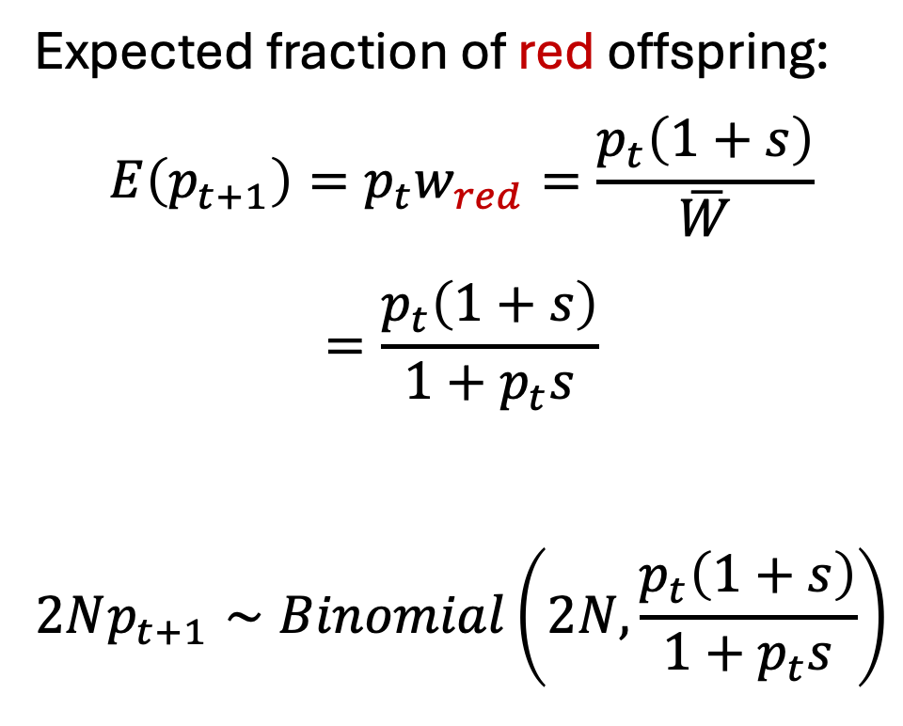
Biased Wright-Fisher sampling
Expected fraction of red offspring:
$$E\left(p_{t+1}\right)=p_{t}w_{red}=\frac{p_{t}\left(1+s\right)}{\overline{W}}$$
$$=\frac{p_{t}\left(1+s\right)}{1+p_{t}s}$$
$$2Np_{t+1}∼Binomial\left(2N,\frac{p_{t}\left(1+s\right)}{1+p_{t}s}\right)$$
One generation
t
t+1

Slide 15
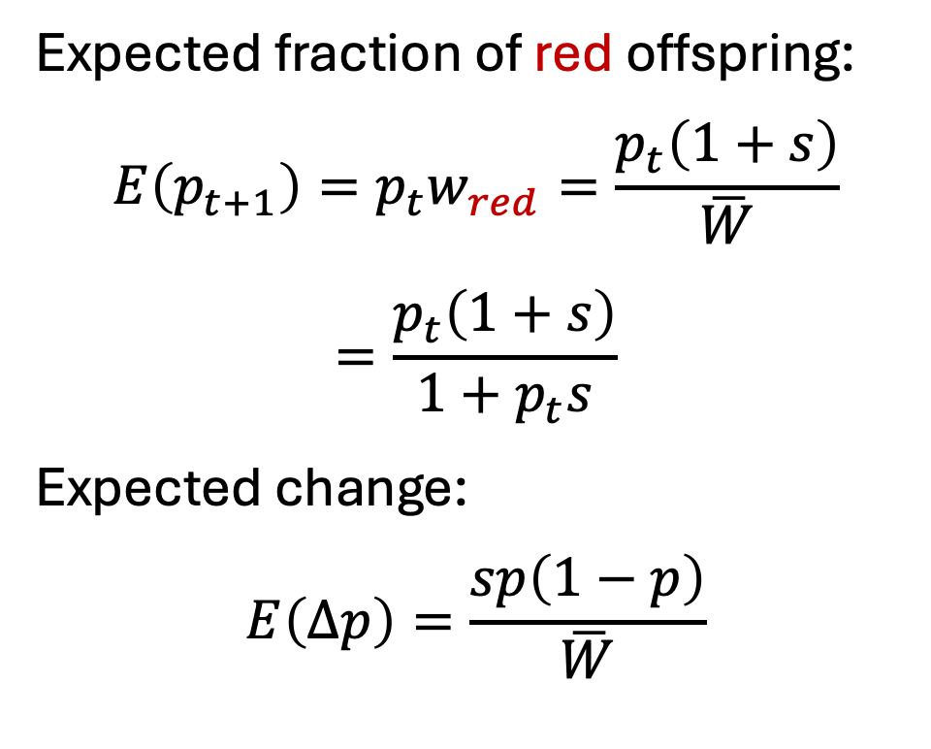
Biased Wright-Fisher sampling
Expected fraction of red offspring:
$$E\left(p_{t+1}\right)=p_{t}w_{red}=\frac{p_{t}\left(1+s\right)}{\overline{W}}$$
$$=\frac{p_{t}\left(1+s\right)}{1+p_{t}s}$$
Expected change:
$$E\left(Δp\right)=\frac{sp\left(1−p\right)}{\overline{W}}$$
One generation
t
t+1

Slide 16
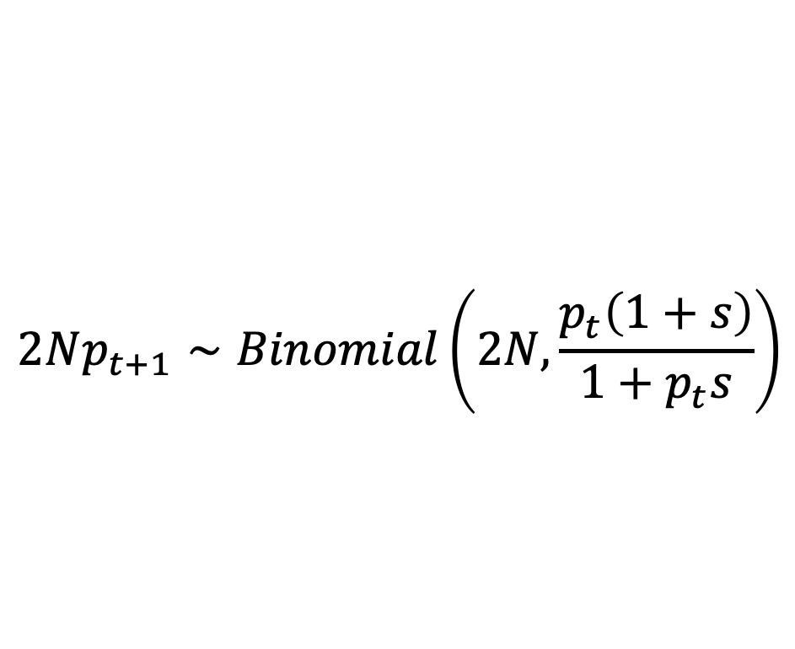
Biased Wright-Fisher sampling
$$2Np_{t+1}∼Binomial\left(2N,\frac{p_{t}\left(1+s\right)}{1+p_{t}s}\right)$$
One generation
t
t+1

Slide 17
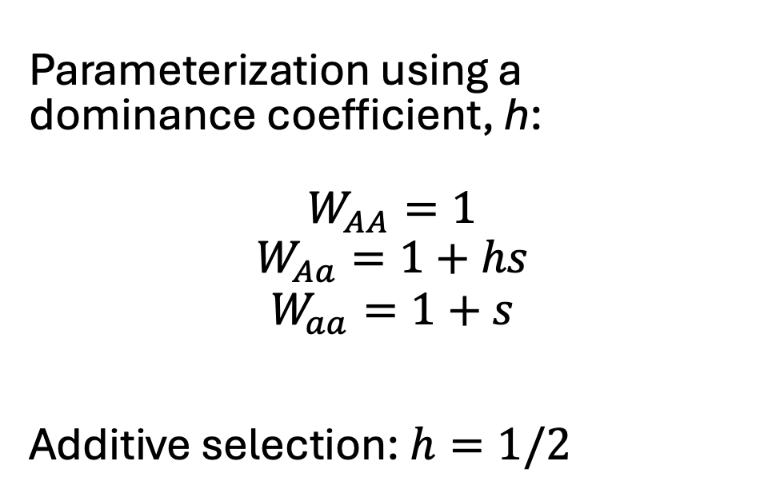
Diploid selection
Parameterization using a dominance coefficient, h:
$$W_{AA}=1$$
$$W_{Aa}=1+hs$$
$$W_{aa}=1+s$$
Additive selection: $h=1/2$
One generation
t
t+1

Slide 18
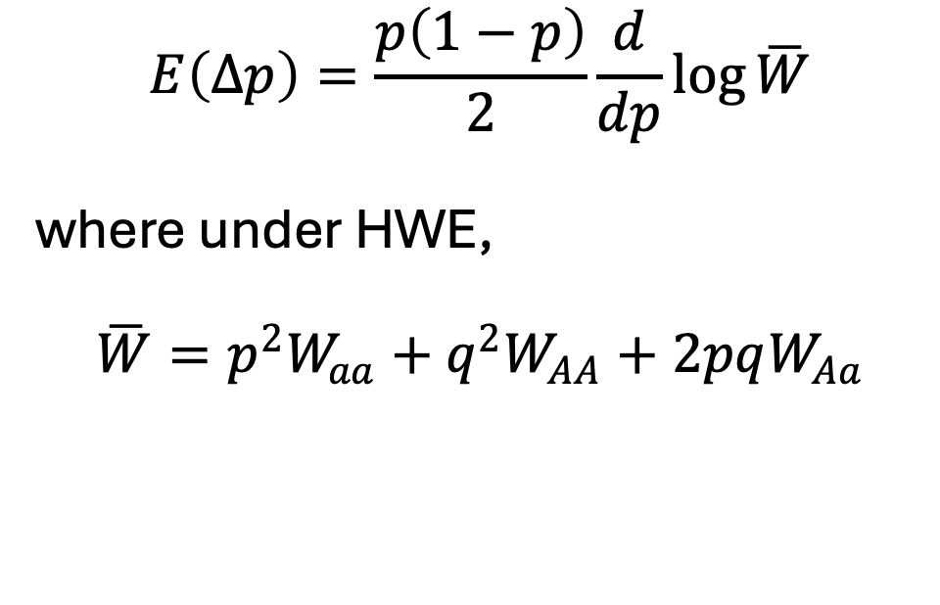
Wright’s Formula
$$E\left(Δp\right)=\frac{p\left(1−p\right)}{2}\frac{d}{dp}\log{\overline{W}}$$
where under HWE,
$$\overline{W}=p^{2}W_{aa}+q^{2}W_{AA}+2pqW_{Aa}$$
One generation
t
t+1

Slide 19
In a large population, selection becomes stronger relative to drift

Slide 20
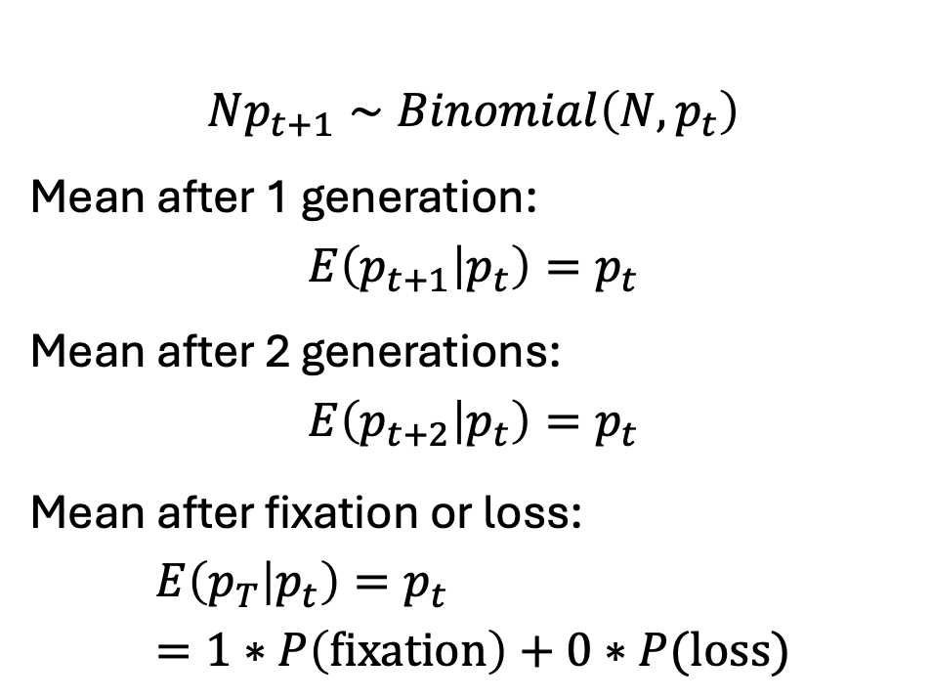
Recall: fixation probability under neutral WF
$$Np_{t+1}∼Binomial\left(N,p_{t}\right)$$
Mean after 1 generation:
$$E\left(p_{t+1} | p_{t}\right)=p_{t}$$
Mean after 2 generations:
$$E\left(p_{t+2} | p_{t}\right)=p_{t}$$ Mean after fixation or loss:
$$E\left(p_{T} | p_{t}\right)=p_{t}=1∗P\left(fixation\right)+0∗P(loss)$$
Many generations
t
t+1

Slide 21
Fixation probability of a beneficial mutation (starting allele count = 1)

Slide 22
Fixation probability of a beneficial mutation (starting allele count = 1) is insensitive to N

Slide 23
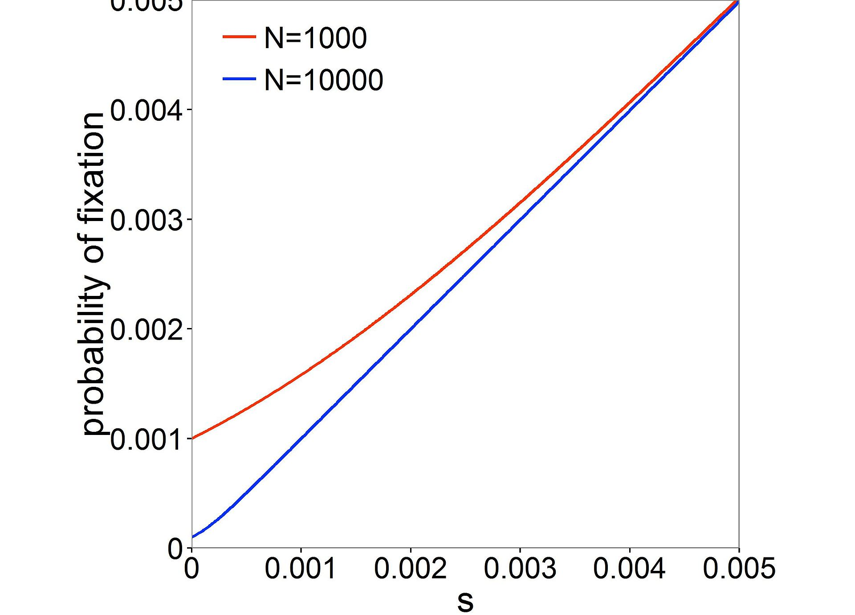

Slide 24
Fixation probability of a deleterious mutation is strongly sensitive to N

Slide 25
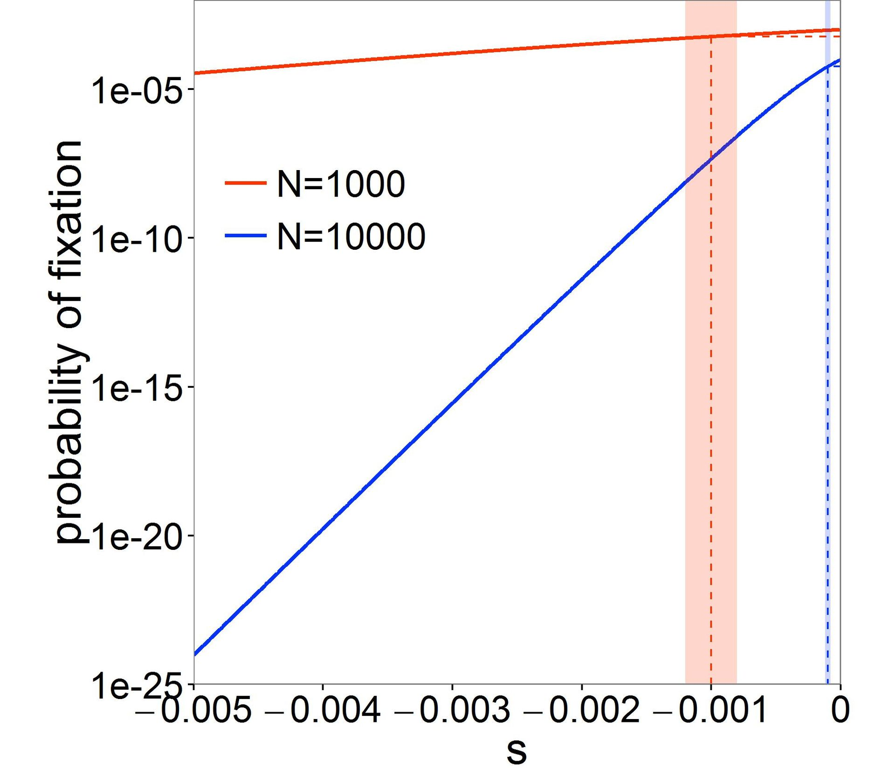
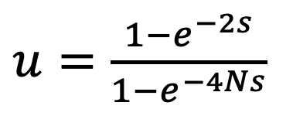
$u=\frac{1−e^{−2s}}{1−e^{−4Ns}}$

Slide 26
Nearly neutral regime
“Nearly neutral”

Slide 27
Strong selection regime
“Strongly selected”
“Nearly neutral”

Slide 28
Weak selection regime
“Weakly selected”
“Nearly neutral”

Slide 29
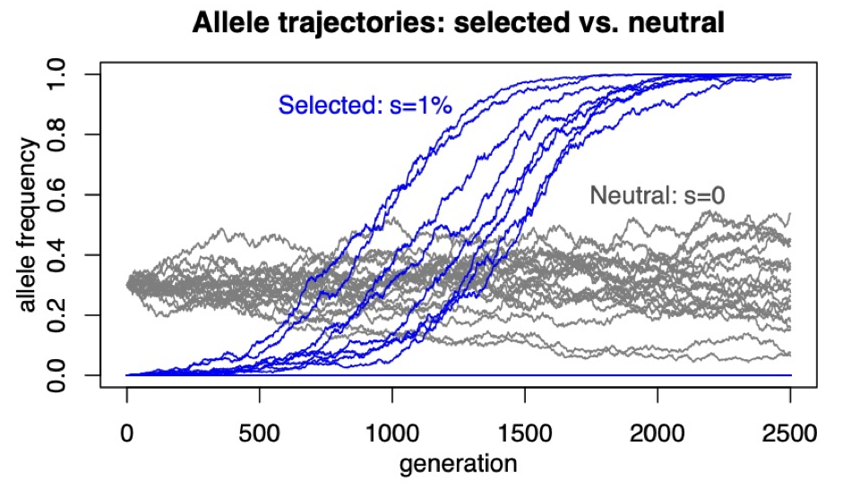
Fixation time of a beneficial mutation is much faster than neutral

Slide 30
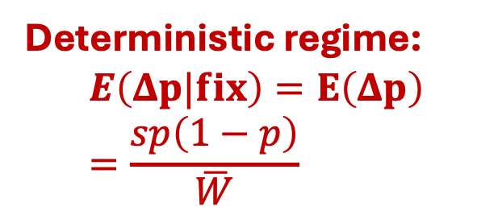
Fixation time of a beneficial mutation is much faster than neutral
Deterministic regime:
$$E\left(Δp|fix\right)=E\left(Δp\right)=\frac{sp\left(1−p\right)}{\overline{W}}$$

Slide 31
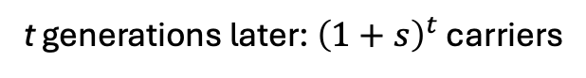
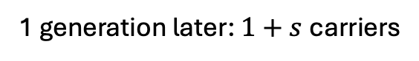
Mutation-selection balance
Mutation event: one carrier
1 generation later: $1+s$carriers
Time
…
t generations later: ${\left(1+s\right)}^{t}$ carriers

Slide 32
Mutation-selection balance
Recurrent mutations
Time
Individuals

Slide 33
Mutation-selection balance
Recurrent mutations
Time
Individuals

Slide 34
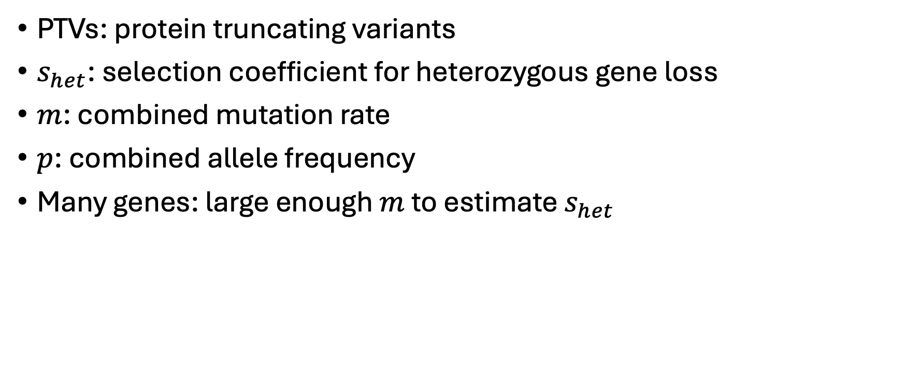
Estimating genic constraint
PTVs: protein truncating variants
$s_{het}$: selection coefficient for heterozygous gene loss
$m$: combined mutation rate
$p$: combined allele frequency
Many genes: large enough $m$ to estimate $s_{het}$

Slide 35

Estimating genic constraint

Slide 36
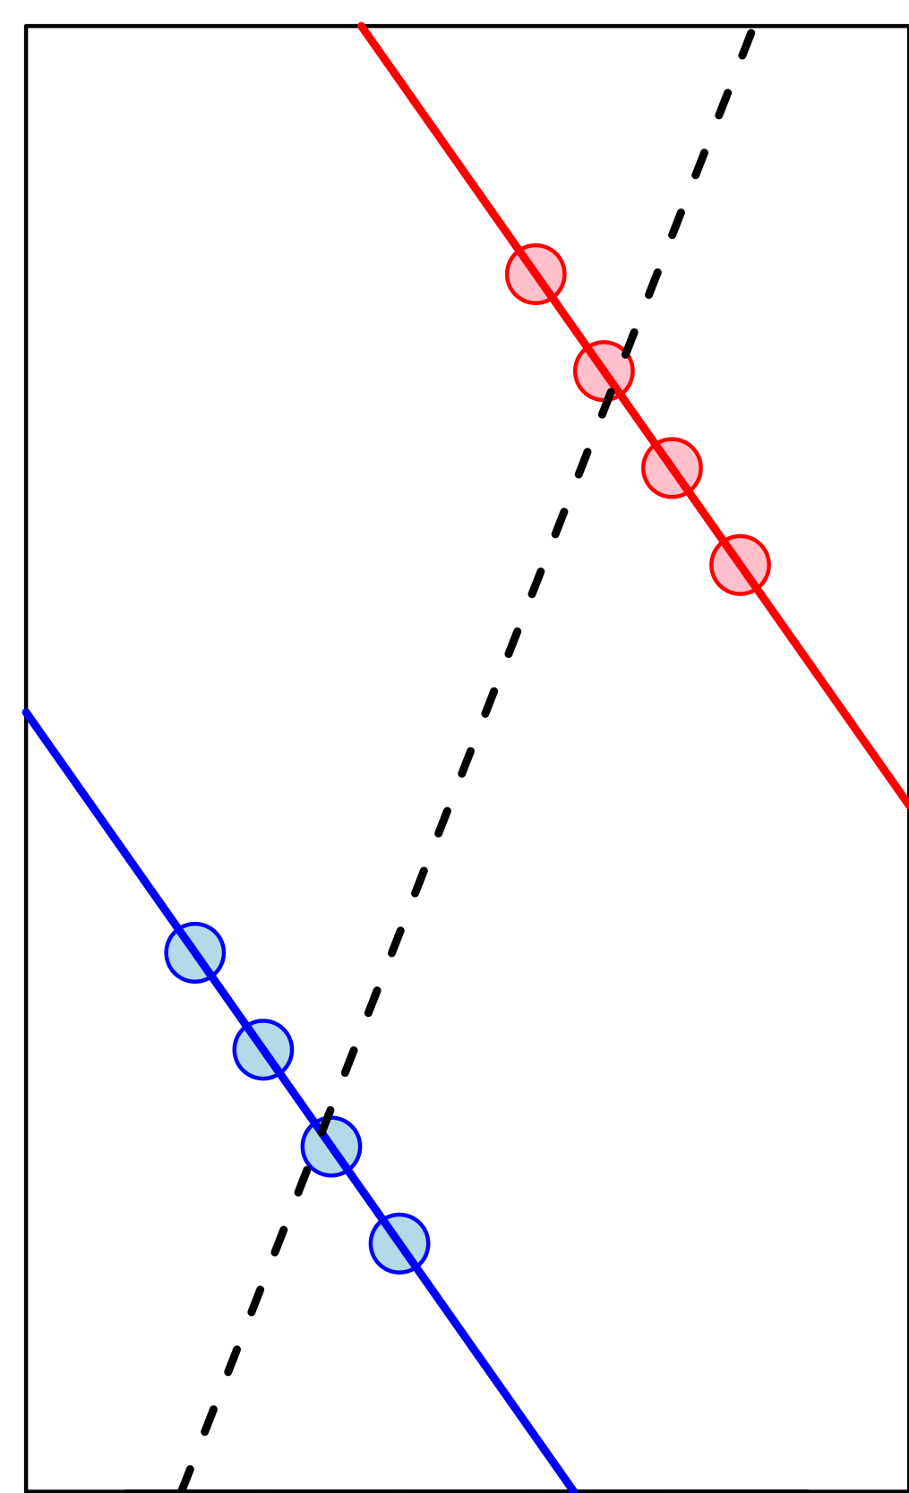
Change in allele frequency for a beneficial mutation conditional on loss

Slide 37
>>cd /local/path/to/repo
>>git pull
>>source bmif201/bin/activate
>>jupyter notebook 02_selection.ipynb

